Slide 1





PrEP delivery in public health settings: Successes and barriers
Moussa Sarr, Westat, United States & Senegal
On behalf of the Senegal PrEP Team
Aardex Group SA, Belgium

Slide 2
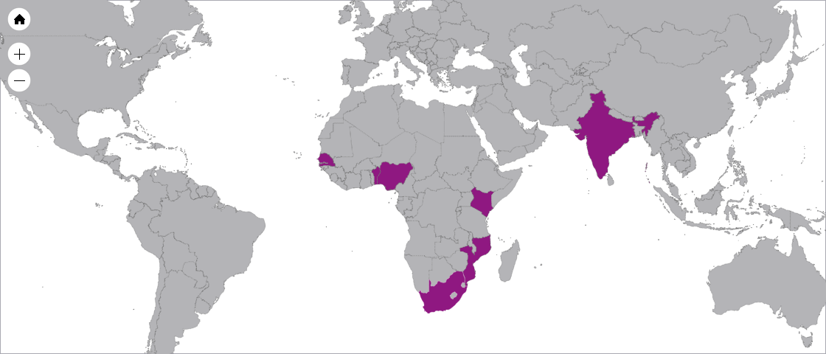
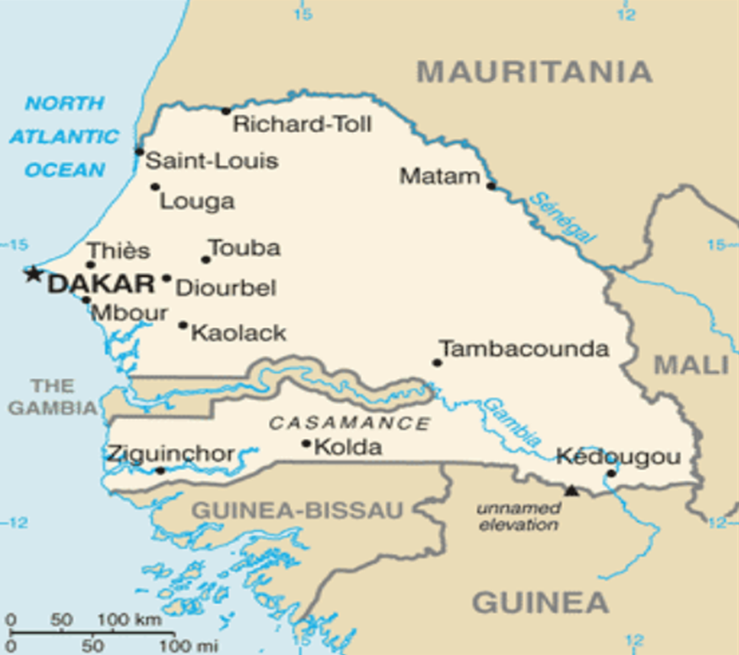
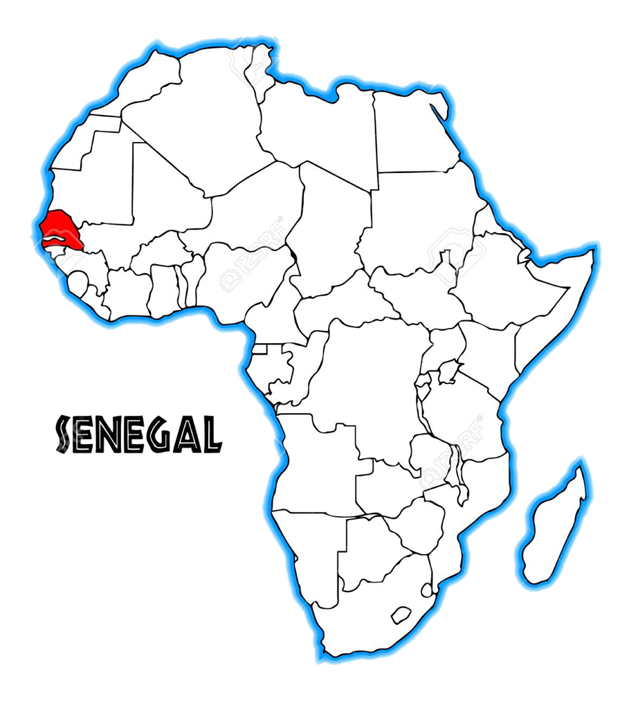

…One of the Demonstration Studies Sponsored by the Gates Foundation
Kenya
India
South Africa
Nigeria
Benin
Senegal
Mozambique
Notes:
Need to expand on this slide

Slide 3
Background
National HIV prevalence <1%
  FSW (30%)
  MSM (19%)
There is a need to move beyond the existing types of interventions;
  Interventions such as community-level and structural HIV prevention types of programs were recently added
Now adding biomedical intervention to help lower the HIV incidence and prevalence among FSWs

Slide 4
Context
PrEP implementation in real-world clinical settings for future scale up plans
  Implemented in 4 Ministry of Health (MoH)-run clinics in Dakar, Senegal
Sex work is legal and regulated in Senegal
  FSWs can register with the system for monthly HIV/STIs visits in MoH-run clinics
The demonstration project enrolled both registered and also unregistered sex workers

Slide 5
Intervention & Measures
Visits: Baseline, 7 days, 1, 3, 6, 9, and 12 months
Medication: Daily PrEP (Truvada) – dispensed day 0, month 1, and every 3 months thereafter
Measures:
      Socio-demographics
      Medical History
      Physical Exam
      Laboratory Test:
        Urine βHCG; Urine dipstick; HIV-1 ELISA; HBsAG and HBsAG⁺; Serum Chemistry, LFT; CBC; STI screening; vaginal swab for Y chromosome PCR; Medication levels
      Behavioral Assessments:
        Social support; Self-reported adherence; Sexual Activity and condom use; Risk perceptions; Alcohol, and drug use assessment

Slide 6
Key Findings - Enrollment and Uptake
x

Slide 7
Population – Socio-demographics
 |  |  | Health Centers / Sites
Parameter |  | Overall | Pikine | Mbao | Rufisque | Diamniadio | p-value*
Age, mean (SD) | Mean (SD) | 38 (8,80) | 36 (9,08) | 38 (7,90) | 40 (8,97) | 37 (8,71)
 | Min | 18 | 20 | 22 | 18 | 18
 | Max | 57 | 53 | 54 | 57 | 57
 | Missing | 0 | 0 | 0 | 0 | 0
Registration Status | Registered | 170 (63,7%) | 63 (86,3%) | 26 (50%) | 47 (71,2%) | 34 (44,7%) | <0.001
 | Non-Registered | 96 (36%) | 10 (13,7%) | 26 (50%) | 19 (28,8%) | 41 (53,9%)
 | Missing | 1 (0,4%) | 0 (0%) | 0 (0%) | 0 (0%) | 1 (1,3%)
Nationality, n (%) | Senegalese | 263 (98,5%) | 72 (98,6%) | 50 (96,2%) | 65 (98,5%) | 76 (100%) | 0.34
 | Non-Senegalese | 4 (1,5%) | 1 (1,4%) | 2 (3,8%) | 1 (1,5%) | 0 (0%)
 | Missing | 0 (0%) | 0 (0%) | 0 (0%) | 0 (0%) | 0 (0%)
Ethnicity, n (%) | Wolof | 110 (41,2%) | 35 (47,9%) | 9 (17,3%) | 28 (42,4%) | 38 (50%) | 0.001
 | Pulaar | 68 (25,5%) | 20 (27,4%) | 16 (30,8%) | 12 (18,2%) | 20 (26,3%)
 | Sereer | 42 (15,7%) | 13 (17,8%) | 11 (21,2%) | 13 (19,7%) | 5 (6,6%)
 | Other | 47 (17,6%) | 5 (6,8%) | 16 (30,8%) | 13 (19,7%) | 13 (17,1%)
 | Missing | 0 (0%) | 0 (0%) | 0 (0%) | 0 (0%) | 0 (0%)
 | Total | 267 (100%) | 73 (100%) | 52 (100%) | 66 (100%) | 76 (100%)
Have you ever attended school? | Yes | 157 (58,8%) | 38 (52,1%) | 27 (51,9%) | 48 (72,7%) | 44 (57,9%) | 0.05
 | No | 110 (41,2%) | 35 (47,9%) | 25 (48,1%) | 18 (27,3%) | 32 (42,1%)
 | Missing | 0 (0%) | 0 (0%) | 0 (0%) | 0 (0%) | 0 (0%)
What is the highest level of school you completed? | Primary | 133 (49,8%) | 25 (34,2%) | 25 (48,1%) | 43 (65,2%) | 40 (52,6%) | 0.007
 | Secondary | 23 (8,6%) | 12 (16,4%) | 2 (3,8%) | 5 (7,6%) | 4 (5,3%)
 | Unlettered | 108 (40,4%) | 33 (45,2%) | 25 (48,1%) | 18 (27,3%) | 32 (42,1%)
 | Missing | 3 (1,1%) | 3 (4,1%) | 0 (0%) | 0 (0%) | 0 (0%)
 | Total | 267 (100%) | 73 (100%) | 52 (100%) | 66 (100%) | 76 (100%)

Slide 8
Key Findings - Retention
After adjustment
68 subjects out of 267 discontinued
One year Retention : 74.5 %
Before adjustment
88 subjects out of 267 discontinued
One year Retention : 67.0 %
Retention over time as estimated by Kaplan-Meier
Adjustment: Reasons of discontinuation such as death, pregnancy, moved out of the area, had a car accident were not counted as events
8

Slide 9
Predictors of Retention
Older age among FSW was found to be a significant predictor of higher PrEP retention (P = 0.0012)
Age Categorized:
  18-24 year age group: 1
  25-34 year age group: (OR= 2.53, 95%CI=1.22-4.99),
  35-44 year age group: (OR= 3.24, 95%CI=1.57-6.23), and
  45+year age group: (OR= 3.85, 95%CI=2.13-10.27)
No significant differences in retention by site, education, registration as sex worker status, condom use or HIV risk perception.

Slide 11
Reasons for non-adherence
Most participants did not take meds when did not feel at risk
3 top reasons of non-adherence
  Simply Forgot (20%)
  Too busy with other things (18%)
  Run out of study pills (14%)

Slide 12
Barriers & Facilitators
Individual |  | Social/Community |  | Structural
Barriers | Facilitators | Barriers | Facilitators | Barriers | Facilitators
Fear of stigma Medication (Daily intake, size, color) Blood test at each visit (quarterly) Mobility Younger age | Personal/ Motivational Interviewing Group Counseling sessions Free treatment of diagnosed STIs Provision of condoms Younger peer-educators | Stigmatization (at the family & community level) | Personal/ Motivational Interviewing Group Counseling sessions (sharing positive stories, experiences and tricks) | Lack of coordination between different sectors within health centers Work load Lack of Research Experience Mobility of site staff Site and laboratory capacity and logistics (freezers, reagents, sample kits) | Trainings of health staff Capacity building and planning evaluation (Lab QMS, Pharmacy SOP, SOP for coordination of activities between different sectors.)
m

Slide 13
Lessons Learned
Successful enrollment and retention of FSWs in PrEP when offered in Ministry of Health (MoH)-run clinics
Challenges
  Sex Worker Population very Mobile
  Despite continuous recommendation of daily PrEP use,
    medication mostly taken when feeling of being at risk
  Human resource and structural issues at facilities
  Challenge of enrolling younger participants
  Personal, social and structural stigma
Personal and group counseling sessions to support enrollment, retention, and adherence

Slide 14
Experience in other public health settings
In South Africa:
  Retention rate was pretty low, but women who really wanted to take PrEP came and stayed
  Mobile services may help with the next stage of reach.
In Swaziland:
  59% clients were retained at 1-month after PrEP initiation.
  very high self-perceived risk of HIV infection, middle age, and having a partner known to be living with HIV were significantly significant predictors of retention at 1-month

Slide 15
What we would do differently
Earlier in the process (top 3):
  Have a higher number of younger peer-educators
  Match the number of participants attending site visits to staff workload:
    Better coordination between peer-educators and site staff
  Better coordination between different sectors within health centers

Slide 16
What to Do Next…
National dissemination meeting with Ministry of Health and key in-country stakeholders
Include recommendations into next in-country National strategic plan
Ministry of Health (MoH)-run clinics can be used possibly used to expand PrEP’s access nationwide
  not only for FSWs, but also for
  other high-risk groups such as Men having Sex with Men (MSM), serodiscordant couples, or IV drug users
Use of an event-driven versus mandatory daily PrEP
Secure funding for scale-up effort

Slide 17
acknowledgements
This study is funded by the Bill & Melinda Gates Foundation; and
Truvada® for pre-exposure prophylaxis is provided free of charge by Gilead Sciences, Inc.
Special thanks to all study participants, all peer-educators, and all site staff
Special thanks also to the Senegal government:
  The National Council Against AIDS / Prime Minister’s Office (CNLS); and
  The Division for the Control of HIV/AIDS and STIs / Ministry of Health (DLSI)

Slide 18
Thank you!!

